Slide 1

lOMoARcPSD|7281087
SCHOOL OF COMPUTER SCIENCE AND ENGINEERING
REPORT ON PYTHON PROJECT
BANKING SYSTEM Application
Submitted to Lovely Professional University
“DEGREE OF BACHELOR OF TECHNOLOGY [COMPUTER SCIENCE AND ENGINEERING]”
Submitted By
Name
Bipul Kumar
Yaswanth Sai
Registration No.
12020242
12007278
Submitted To:
Dr. Sagar Pande Sir
Project Link-
https://github.com/bipulkumarb/Bakinng-management-system-in-python.git
1

Slide 2
lOMoARcPSD|7281087
ABSTRACT
The goal of this project was designing a platform by which we can get idea as the balance and check out of bank website and functioning of data in the database of the banking system .
With the help of Python we can able to Receipt and bank statement . We used python to code for this application and had designed the Bank management system.
The adoption of Electronic Banking by commercial enterprises has been inexistence since the mid 90’s. Much greater in number due to lower operating costs associated with it. Electronic banking has initially been in the form of automatic teller machines and telephone transactions.
More recently, it has been transfer made by the Internet, a new delivery channel for banking services that benefits both customers and banks. Internet banking system services can include: Open an account, Balance enquiry, Beneficiary payments (EFT), viewing monthly, Furthermore, customer’s application for electronic transactions over the Internet are significant.
Our Project basically have two main things:
Building UI (front-end).
Write Python Code(Back-end).
All functions of the banking systems are specified.
2

Slide 3
lOMoARcPSD|7281087
Acknowledgement
We take this opportunity to present our votes of thanks to all those guidepost who really acted as lightening pillars to enlighten our way throughout this project that has led to successful and satisfactory completion of this study. We are really grateful to our teacher for providing us with an opportunity to undertake this project in this university and providing us with all the facilities. We are highly thankful to Dr. Sagar Pande for his active support, valuable time and advice, wholehearted guidance, sincere cooperation and pains-taking involvement during the study and in completing the assignment of preparing the said project and in course within the time stipulated.
Lastly, we are thankful to all those particularly the various friends who have been instrumental in creating proper, healthy and conductive environment and including new and fresh innovative ideas for us during the project, their help, it would have been extremely difficult for us to prepare the project in a time bound framework.
3

Slide 4
lOMoARcPSD|7281087
 | TABLE OF CONTENTS
Title Cover Page |  | Page 1
Abstract |  | 2
Acknowledgement |  | 3
Table of Contents |  | 4
List of figures |  | 4
Introduction |  | 5+
Home Page |  | 6
Sub Page |  | 7
Study Materials |  | 8
Project Contribution |  | 9
Results |  | 10-15 ++
References |  | 16
 | List of Figures
Figure number | Topic | Page number
1 | Starting of Page | 8
2 | Sub Page | 9
3 | Application details | 10
4 | Results | 12-15
4

Slide 5
Introduction
lOMoARcPSD|7281087
General Information:-
Usually all persons want money for personal and commercial purposes. Banks are the oldest lending institutions . They are providing all facilities to all citizens for their own purposes by their terms. To survive in this modem market every bank implements so many new innovative ideas, strategies, and advanced technologies. For that they give each and every minute detail about their institution and projects to public.
They are providing ample facilities to satisfy their customers i.e. et banking, mobile banking, door to door facility, instant facility, investment facility, demat facility credit card facility, loans and advances account facility etc. And such banks get success to create their own image in public ad corporate world. These asks always accepts innovative notations in scenario like credit cards, ATM machines, risk management etc. so, as a student business economics I take keen interest in world economy ad for that also are the main source of development.
So this must be the first choice for me to select this topic. At this stage every person must know about new innovation technology of procedure new schemes and new ventures.
Because of the following reasons, I prefer this project work to get the knowledge of the banking system.
Banking is an essential industry.
It is where we often wind up when we are seeking a problem in financial crisis and money related query.
Baking is one of the most regulated businesses in the world.
Banks remain important source for career opportunities for people.
It is vital system for developing economy for the nation.
Banks can play a dynamic role in delivery ad purchase of consumer durables.
5

Slide 6
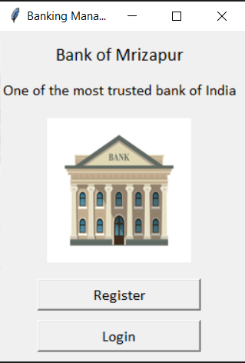
Home Page
lOMoARcPSD|7281087
Home page is a web page set as the default or start-up page on a browser with title and image of platform “Banking System”.
Our home page have following components:-
Header consists of the logo of our platform "Banking System”.
Body of UI have different Background color of body is simple, dark black and lite gray light.
Overall it’s a classical and user-friendly User Interface.
6

Slide 7
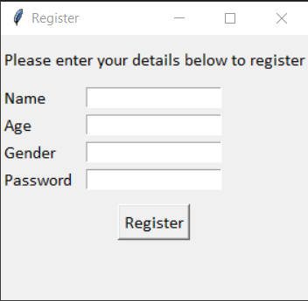
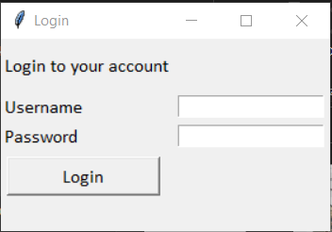
Sub -page
lOMoARcPSD|7281087
The above pop up will appear when we will click on Register button. Here we can enter our personal details.
The above pop will appear when we will click on Login button.
7

Slide 8
Application Details
lOMoARcPSD|7281087
Benefits of the application (UI):-
User Friendly.
Fully Efficient.
Easy to Handle customer account.
Provided better account management facilities
Processor , memory and disc space are minimized .
Can perform required function stably.
The accuracy of its output is good.
Our program can be used many times.
8

Slide 9
Project Contribution
lOMoARcPSD|7281087
Materials
Sublime Editor: - We used sublime editor to make the UI using HTML, CSS and JS
VS code: - All the python codes performed on VS code and connection to UI.
Methods
We have divided our work in two parts:
Front-end (Making user interface).
Back-end (Python codes).
The first on is done by Yaswanthsai and the second part is done by Bipul Kumar.
Both works are doing simultaneously on different platforms after completion we just connect them using django.
Discussion
We had a discussion on the following topics:-
Which platform to be used and language to form User Interface(UI).
Color theme of our User Interface (UI).
Working of the Application in basic way.
Conclusion
We ended-up our discussion by making this as user friendly to children and making ideal to know out money by the application(UI).
Its very simple, clear and easy to maintain the storage and no lag to the system.
9

Slide 10
Administrative Requirement Functional Requirement: functional requirements in our systems are as follows: -→ purpose : To register a new customer. -→Inputs : The required data for registration of a new customer in the bank (Like Name, Age , Gender etc ). -→Objects : A Success Message be displayed on successful registration or else an error message will be displayed.
Requirements :-
As some of the banking site doesn’t have a user friendly interface. So, we decided to develop a “Bank Manager” that will contain all those features fulfilling the client basic need by having a professional yet welcoming Interface. “Bank- Manager” is providing solution to that problem.
Our System is a user specific and is for all types of users. Our System operates on window’s operation system. Easily accessible to all type of users.
Key notes of the Bank Management steps:-
Dealing in money- money given by depositors.
Acceptance Of Deposit:- A bank accepts money from the people in the form of deposits which are usually repayable o demand or after the expiry of a fixed period. It gives safety to the deposits of its customers. It also acts as a custodian of funds of its customers.
Giving Advances: a bank provides various banking facilities to its customers..
Payment & with withdraw- A bank provides easy payment and withdrawal facility, It also brings bank money in circulation. This money is in the form of cheques, drafts, etc.

Slide 11
Agency & Utility Services:- A bank provides various banking facilities to its customers. They include general utility services and agency services.
Profit & Services Orientation:- A bank is a profit seeing institution having service oriented approach.
Ever Increasing Function:- Banking is an evolutionary concept. There is continuous expansion and diversification as regards the functions, services ad activities of a bank.
Connecting A link :- A bank acts as a connecting link between borrowers and lenders of money. Banks collect money from those who have surplus money ad give the same to those who are in need of money.
Banking Business:- A bank’s main activity should be to do business of baking which should not be subsidiary to ay other business.
Report :-
Client Report:- We can show saved data regarding account management within the database.
Account Report:- We can show the money transaction by client, time, data, and the total amount of account.
Final Report:- At last the final reports, which will show every record regarding client, total amount and withdraw by client.
Security Requirement:-
Account ID and Password (PIN) Protection
Sign-off Button
Failed Log-on Attempts
Encryption

Slide 12


Results
lOMoARcPSD|7281087
Interface
Enter your details to register
10

Slide 13
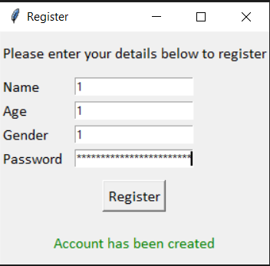

lOMoARcPSD|7281087
Account Created
Enter Username and Password to Login
11

Slide 14
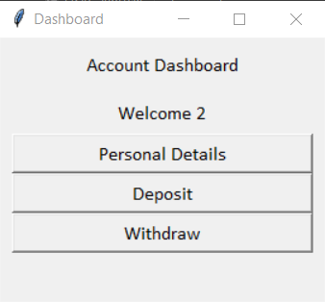

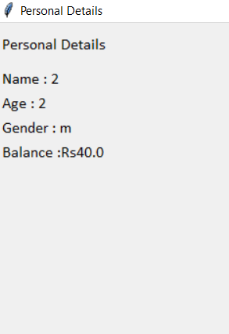
Account Dashboard
Personal Details

Slide 15
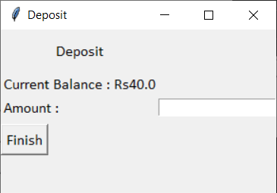

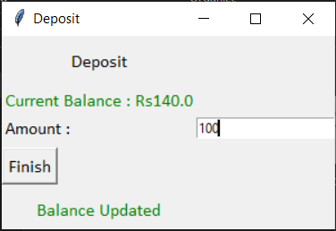
Deposit Balance
Balance Deposited

Slide 16
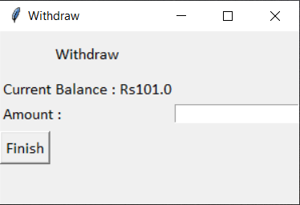
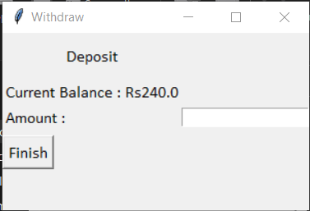
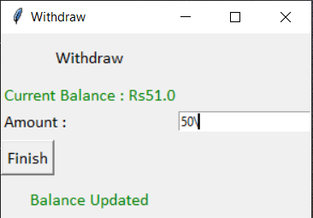
Enter Balance to be Withdrawn
Balance Withdrawn

Slide 17
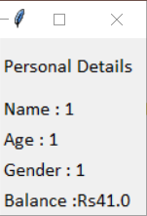
We can look Our Balance after final Transaction
THAT’S THE END OR OUR PROGRAM

Slide 18

References
lOMoARcPSD|7281087
https://www.geeksforgeeks.org/python-gui-tkinter/
https://www.geeksforgeeks.org/working-images-python/
https://www.smashingmagazine.com/2018/01/visual-studio-code/
https://www.youtube.com/watch?v=ng5H3lGZ4m8&ab_channel=johangodinho
https://www.slideshare.net/chsajiid/banking-management-system-project-documentation
https://www.udemy.com/course/python-programming-beginner-to-advanced/learn/lecture/17436246?start=15#overview
https://code.visualstudio.com/
https://www.python.org/
https://docs.python.org/3/library/tkinter.html
https://pypi.org/project/Pillow/
https://stock.adobe.com/sk/search/images?k=cartoon+bank
Thank You!
16

